Slide 1
Innovations in Version 5 of the North Carolina Statewide Travel Model (NCSTM5)
NCAMPO

Slide 2
Overview of Innovations
New Machine Learning Models
Handling Remote Work from Home
Improved Truck Routing
Improved Intercity Passenger Flows
CAV Scenario Testing Functionality

Slide 3
New Machine Learning Models

Slide 4
Population Synthesis
Common in advanced MPO models (Triangle, Charlotte)
Generate a list of households, and people in them that have the same characteristics as the real population
Have been few statewide models with synthetic population due to runtime considerations
TransCAD’s Iterative Proportional Updating (IPU)
  Extremely fast, ~ 1 minute per million people – runs during model run

Slide 5
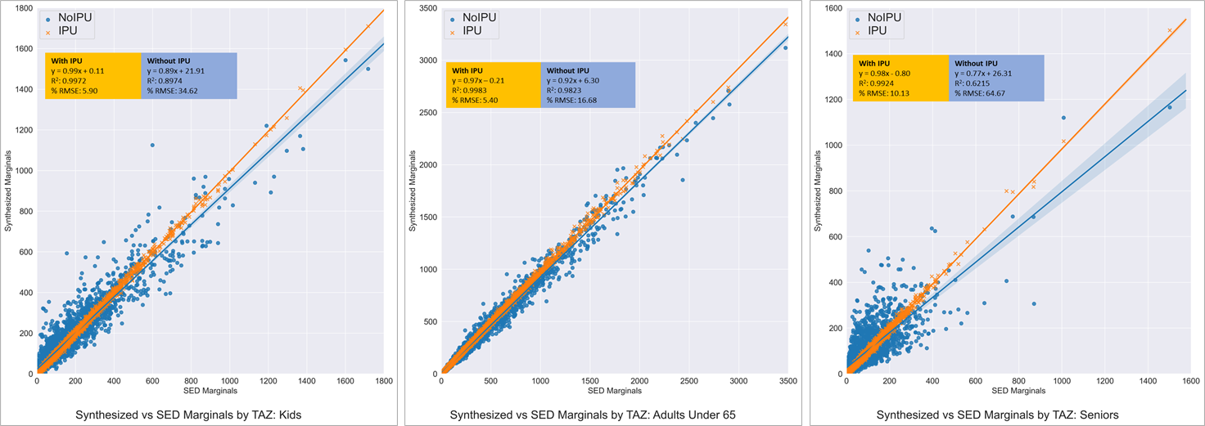
Population Synthesis
Person level attributes show benefit of IPU over IPF
Notes:
Note the accuracy & the SPEED – 1 million people per minute means we can synthesize a population for all NC in about 10 minutes

Slide 6
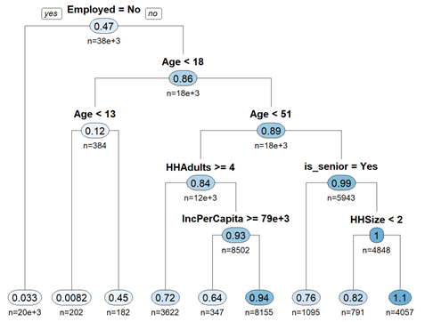
Trip Generation by Decision Trees
The game of 20 Questions
Advantages of Decision Trees
  Sensitivity
    Age
    Neighborhood / Accessibility
    Income
    Vehicle ownership
    Household composition
  Nonlinear effects
  Full survey support
    No empty cells like with cross-class
Notes:
Note the sensitivity to age, and therefore aging population

Slide 7
Comparison with Traditional Models
Tested classical stats &
plain AI methods
  Cross-classification
  GLM (up to and including
  zero-inflated negative binomial)
  Logit (ordered logit)
  Extreme Gradient Boosted
  Decision Trees (XGBoost)
Chosen approach: Explainable Artificial Intelligence (XAI)
  ANOVA-based Rationalized Decision Trees
  Explainable, reasonable relationships between trip rates and explanatory variables
  Confidence that the model is not over-fit to the data
Example: School Trips
Model Type | Pseudo R²
Logit | 0.03
GLM (Regression) | 0.22
Cross-Class | 0.33
XGBoost | 0.60
XAI ANOVA Decision Tree | 0.53

Slide 8

PBHRDC Models
Currently testing new ensemble methods for NC statewide model
Form of doubly-boosted model
Regression on continuous variables expected to affect everyone (income, age, accessibility)
Decision tree on first residual using categorical variables (gender, employment, marital status, etc.)
Asserted tree on “personas”
Regression
Decision Tree
Personas
$$\vec{β}\vec{x}+γ+δ=rate$$

Slide 9
Regression
Age
Income

Slide 10
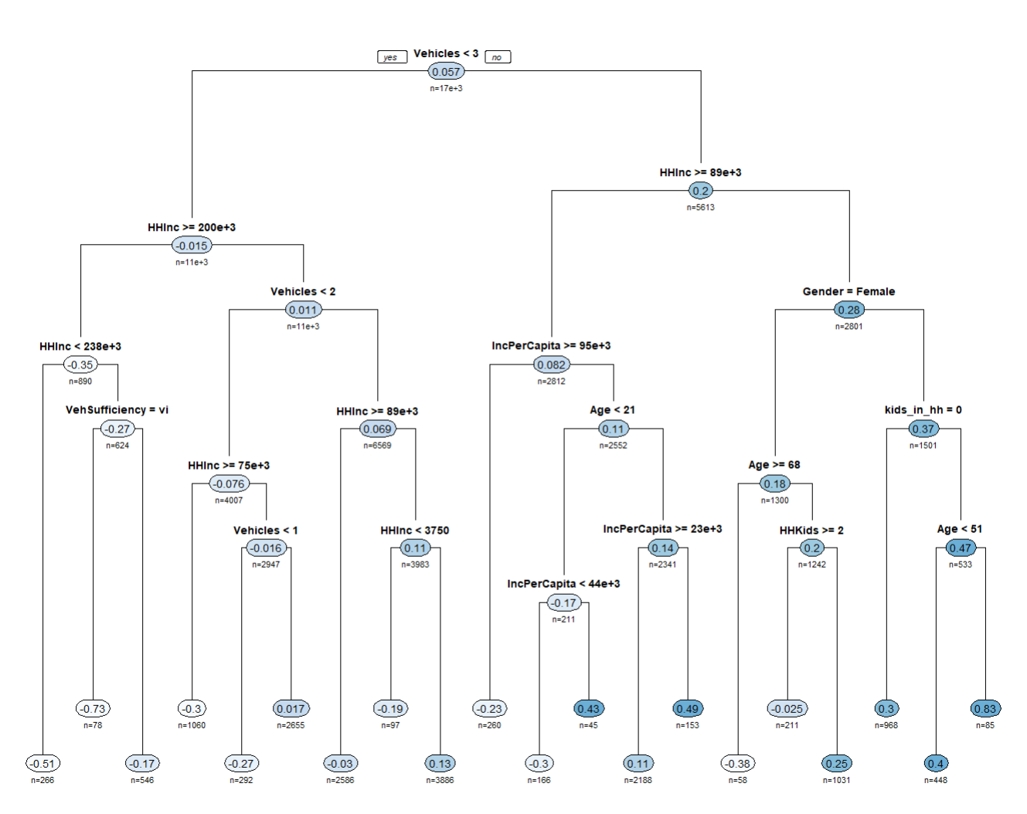
Decision Tree
ANOVA-based Decision Tree
Game of 20 Questions for
γ constant

Slide 11

Persona Constants
$$\vec{β}\vec{x}+γ+δ=rate$$
Lookup δ constant (average second residual) for each “persona”
Multigenerational Family | Senior
 | Dad
 | Mom
 | Adult Child
 | Child
Senior(s) & Child(ren) | Senior
 | Child
TradFam | Dad
 | Mom
 | Adult Child
 | Child
Working Parents | Dad
 | Mom
 | Adult Child
 | Child
Single Parent | Parent
 | Child
Adult Parent(s) Adult Child(ren) | Adult Parent
 | Adult Child
Senior Parent(s) Adult Child(ren) | Senior Parent
 | Adult Child
Senior Couple | Senior
DINK | Worker
SINK | Worker
 | NonWorker
NINK | NonWorker
Other Families | Worker
 | Non-Worker
Sinlges | Worker
 | Non-Worker
Roommates | Worker
 | Non-Worker

Slide 12
HANDLING Remote Work From Home

Slide 13
Remote Work from Home
Has varied considerably over time, future is uncertain
But has significant impact on peak period traffic

Slide 14

Remote Work from Home
Disaggregate remote work from home model
Reflecting how remote workers tend to be
higher income and older workers
Model user will be able to test different assumptions about future work from home rates
  Slightly decreasing, following
  recent trend since COVID
  Hold constant at current rates
  Slightly increasing like before COVID
  Increasing significantly in the long run
  like the long-term trend

Slide 15
Improved Truck Routing

Slide 16
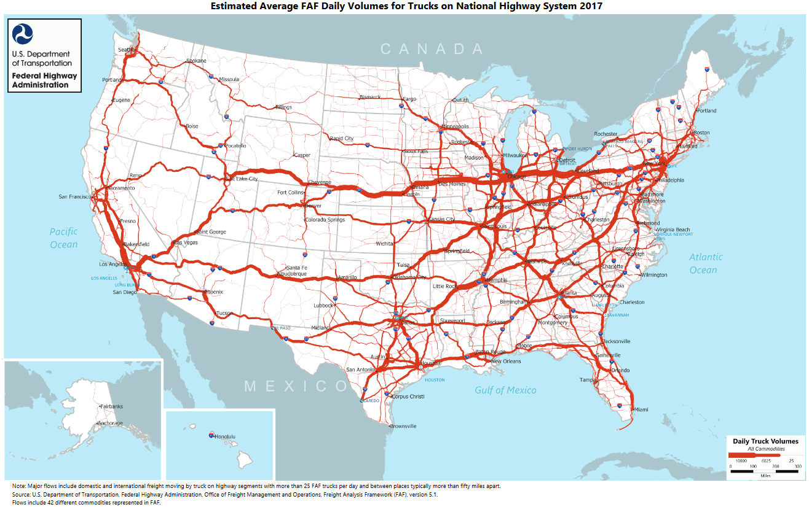
FAF5 Truck Flows
FAF5 used a new method for routing trucks
In the past, all trucks were routed along the fastest path
Now, trucks can take several paths

Slide 17
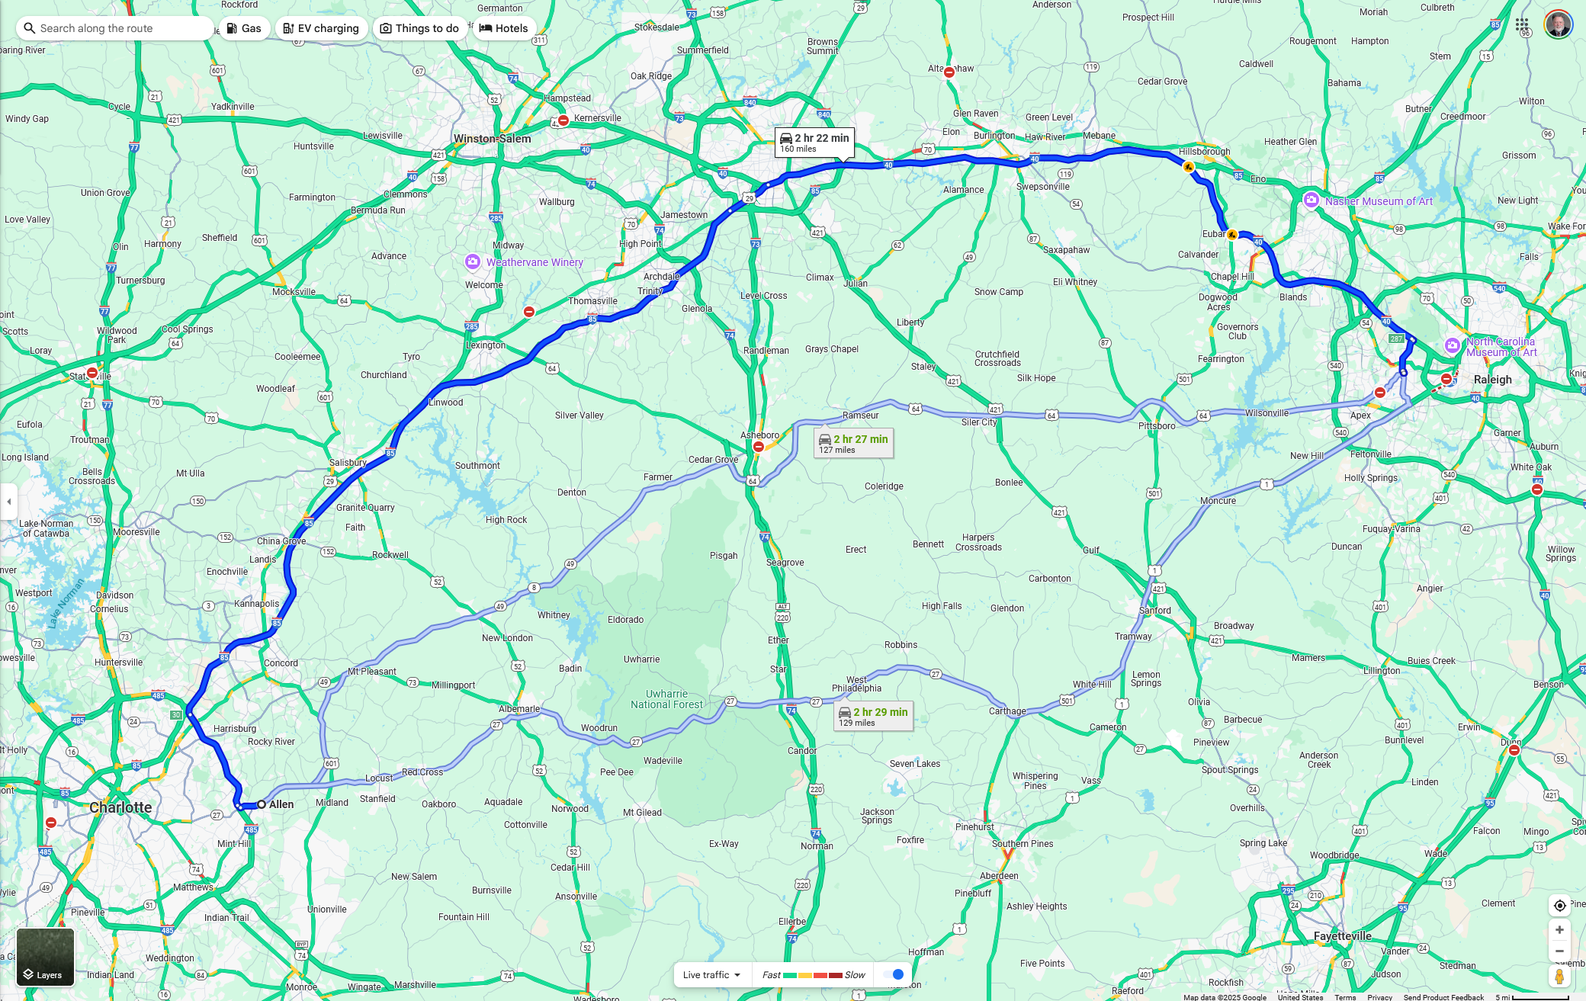
Path Enumeration
Up to four paths generated for each OD pair
Example: Charlotte, NC to Raleigh, NC

Slide 18
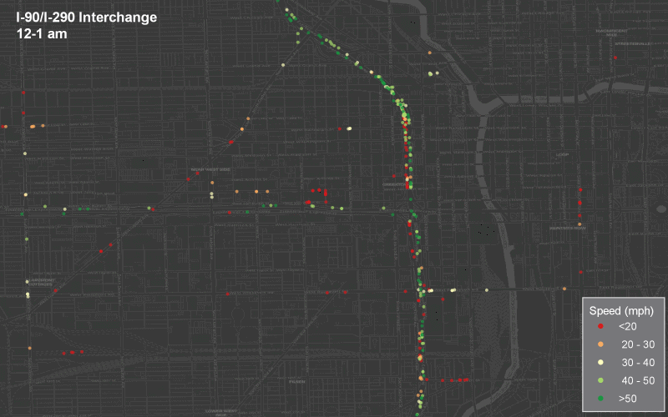
ATRI Truck GPS Data
Over 5 billion sitings
Over 250,000 individual trucks

Slide 19
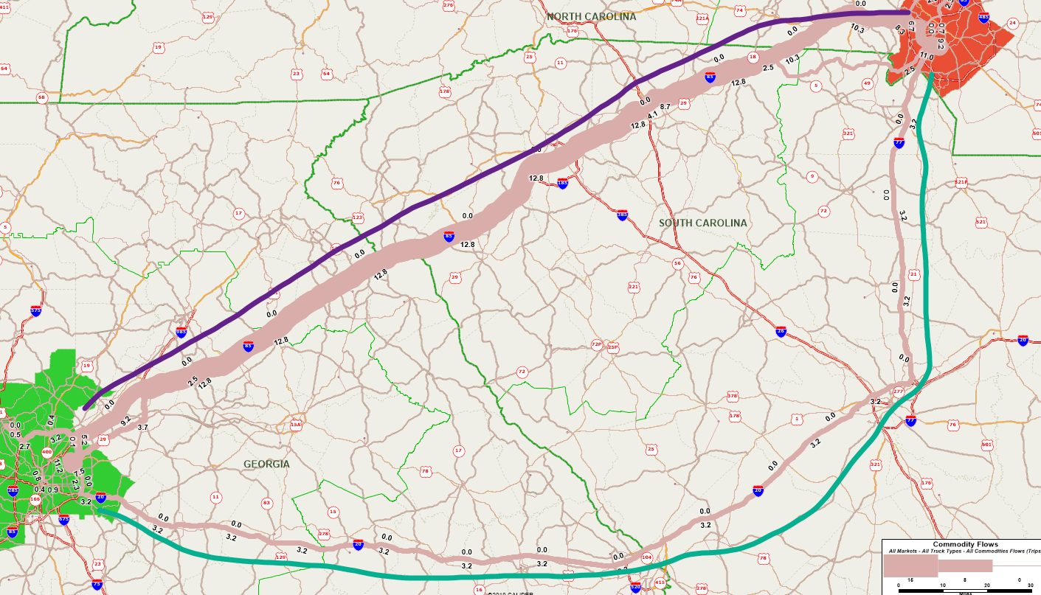
Example FAF5 Truck Routing
Charlotte – Atlanta
Some LTLs stop in Augusta & Columbia
Route | ATRI | FAF5
I-85 | 89% | 80%
I-20 / I-77 | 10% | 20%

Slide 20
Improved Intercity Passenger Flows

Slide 21
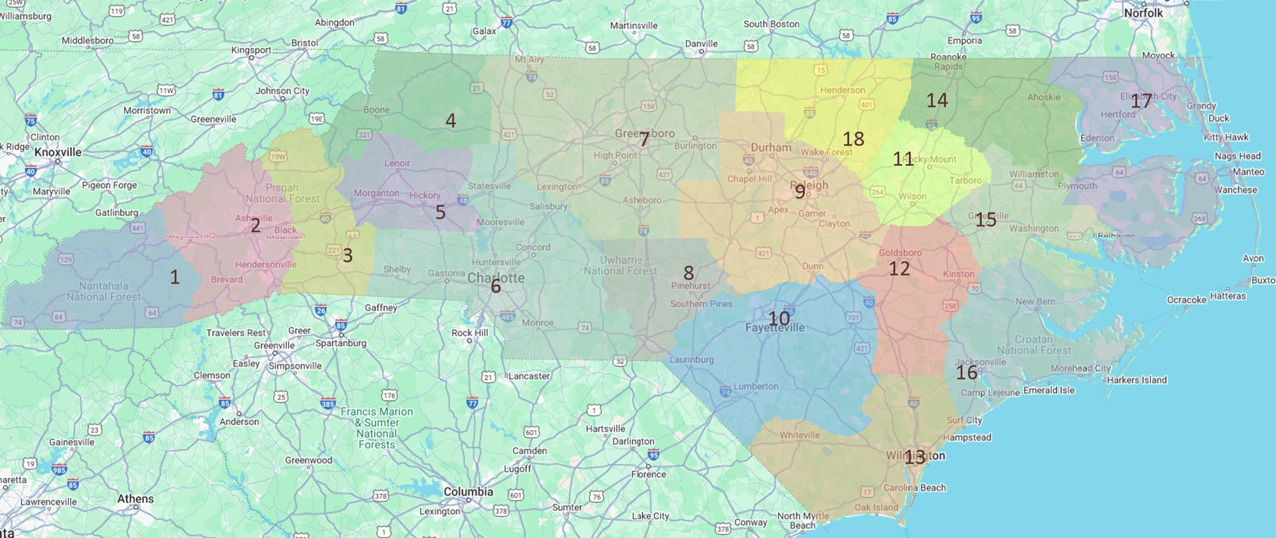
The Challenge
Long-distance / intercity travel patterns in NC are complex because NC is very multi-nucleated
New NCSTM5 should do a much better job of reproducing actual intercity travel patterns in NC
Notes:
Map shows possible regions for new NCSTM

Slide 22
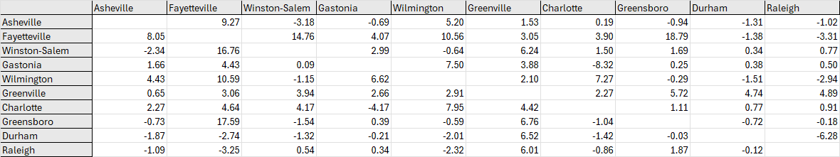
City to City Goole Time Comparisons
Used TransCAD’s links with Google APIs
Estimated % difference between TC and Google travel times
Updated speeds on NC-87
Final travel times were 1% different than Google on average

Slide 23
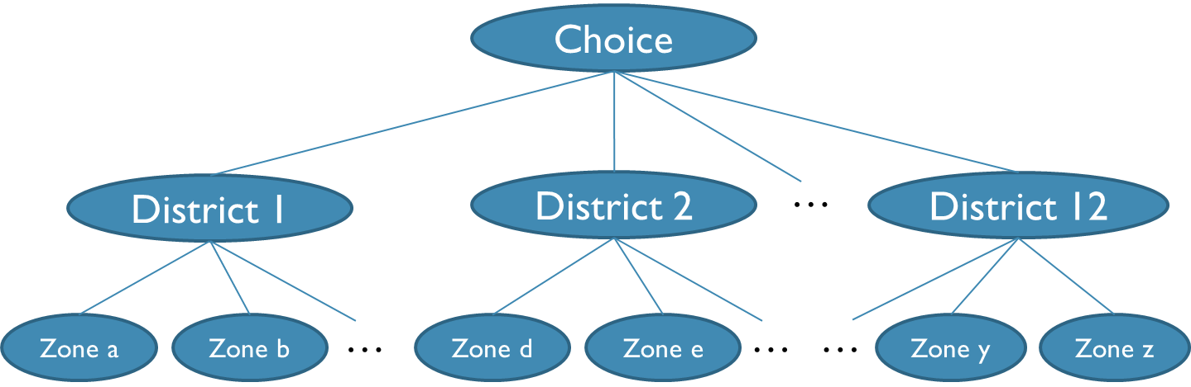
Nested Destination choice for Long Trips
First, travelers choose a destination region
Second, travelers choose the exact zone
Allows much better representation of travel
in multinucleated regions
Notes:
Issues with Streetlight long-distance trips

Slide 24
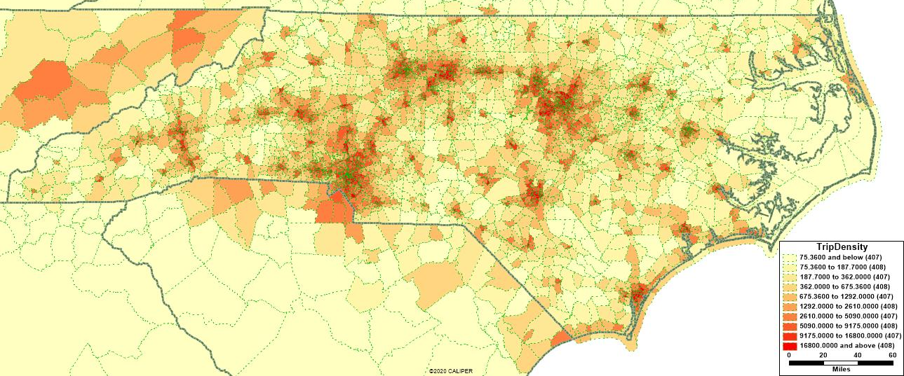
Calibrated to Big Data

Slide 25
CAV Scenario Testing

Slide 26
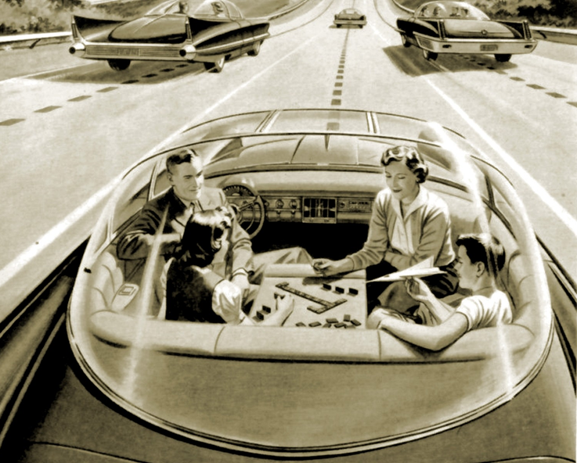
Adding CAV Functionality to NCSTM
Support scenario planning
Adjustment factor “knobs”
  auto ownership
  trip generation
  destination choice
  time-of-day
  capacities
Add module for ZOV trips / deadheading

Slide 27
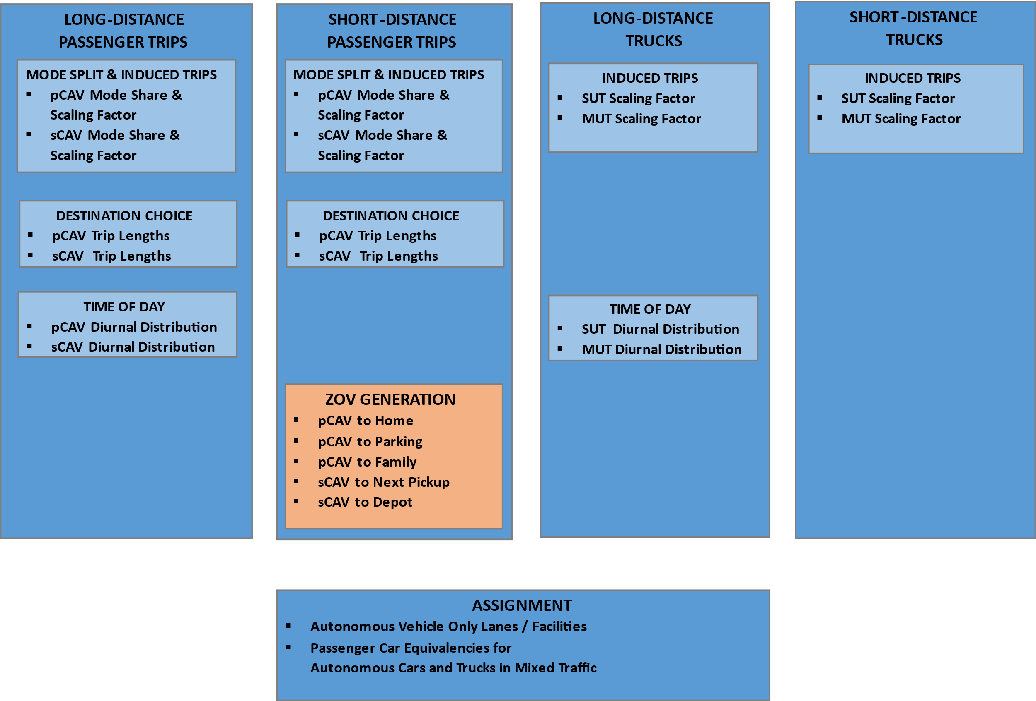
CAV Functionality

Slide 28
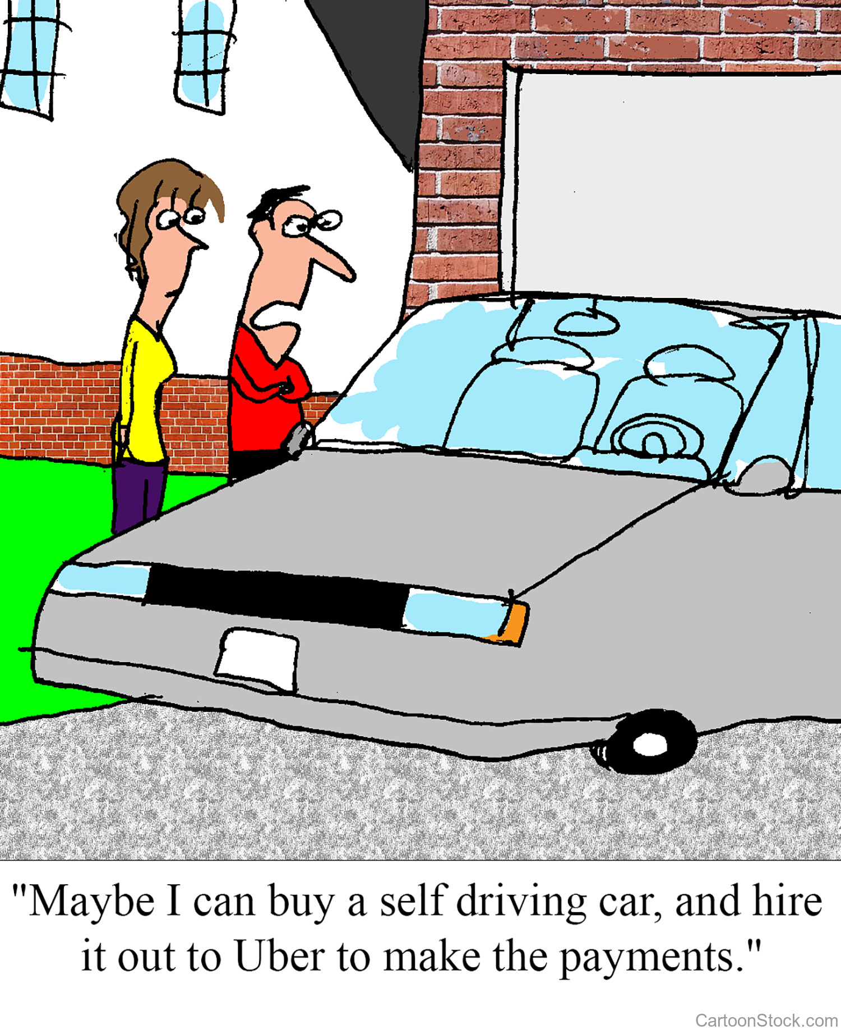
Auto Ownership
Subdivide HH autos into conventional and CAV by income
Decrease overall ownership

Slide 29
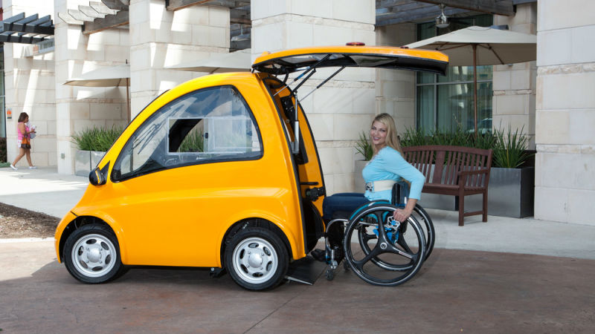
Trip Generation
Scale up trips
to represent
induced demand
Largest increases to
households with:
  Disabled
  Seniors
  Children
More long distance / external trips from reduced lodging cost?
Source: Jalopnik.com

Slide 30

Destination Choice
Passengers may be willing to travel farther since time in CAVs can be used positively for working, relaxing, sleeping, etc.
User can factor down traveler sensitivity to travel time / impedance

Slide 31
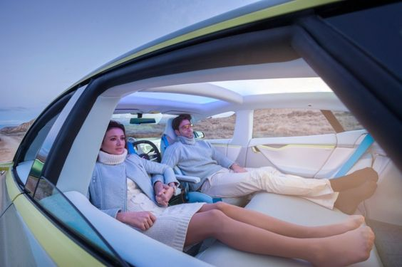
Time of Day
Trucks / long distance travelers may shift to nighttime hours to avoid congestion
Long distance travelers may use sleeping hours to travel

Slide 32
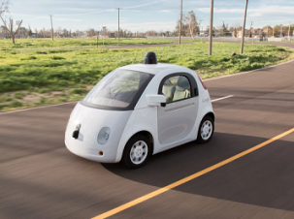
Deadheading / Zero Occupant Vehicles
Types of ZOV trips
  Private CAVs
    for car sharing among
    household members
    to avoid paid parking
      by parking at home
      by parking elsewhere
      by circulating instead of parking
  Shared CAVs
    Between passenger drop-off and pick-up
Source: driverlesstransportation.com

Slide 33
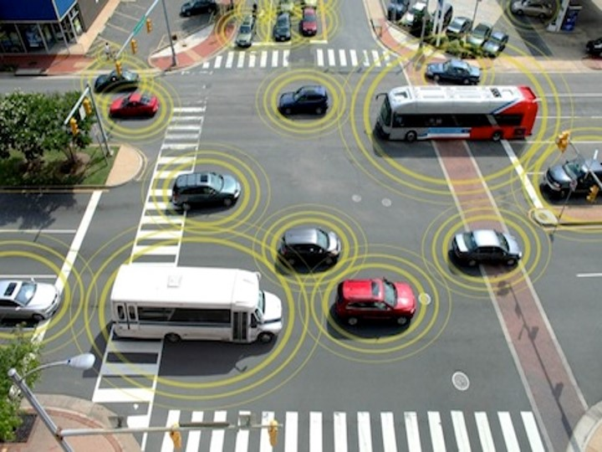
Assignment
Separate autonomous and conventional vehicle classes
User option to have dedicated CAV-only facilities/lanes and assert high capacities
and higher speeds
User option to
assert different
capacity consumption
in mixed traffic
(through PCE factor)

Slide 34
Vince Bernardin, PhD | Vice-President
vince@caliper.com | +1 812-459-3500

